Slide 1
Chapter 19
One-Way ANOVA Repeated Measures

Slide 2
Learning Objectives
Explain the concept of one-way ANOVA repeated measures
Describe the principle and assumptions of one-way ANOVA repeated measures
Design one-way ANOVA repeated measures
Explain how the research problem is formulated for one-way ANOVA repeated measures
Explain how the hypotheses are expressed in one-way ANOVA repeated measures

Slide 3
Demonstrate the steps used in SPSS to execute one-way ANOVA repeated measures
Explain how to analyse and interpret the SPSS outputs of one-way ANOVA repeated measures
Describe the important formulae and calculations of main ANOVA table
Report the final results of one-way ANOVA repeated measures

Slide 4
Introduction
One-way ANOVA repeated measures is an experiment design in which subjects or objects are measured in a repeated manner, aiming to ascertain whether significant change occurs in the dependent variable.
The number of repeated groups in the experiment is same as number of treatments exposed (measured at nominal scale). The subjects or objects are same in each group.
Application of one-way ANOVA repeated measures is employed in the situations, where each individual subject or case is exposed to multiple levels of treatment of independent variable.

Slide 5
Principle of One-Way ANOVA Repeated Measures
Total Variation in Subjects
Treatment Effect
Within-Treatment Variation
Variance between the Subjects
Error Variance

Slide 6
One-way ANOVA repeated measures Ss_{between} = Ss_{condition}.
SS_{condition} represents the variance due to treatment effect in the experiment.
One-way ANOVA repeated measures Ss_{error} = SS_{within-subjects}.
SS_{within-subjects} partitions into difference in variance between the subjects (SS_{between}) considering each subject group as block and unexplained variance.

Slide 7
Source of Variance
Table 19.1. Source of Variance: One-Way ANOVA Repeated Measures
Source of Variance | Cause of Variability | Degree of Freedom | Sum of Squares (SS) | Mean Sum of Squares (MS) | F-statistic (or F-ratio)
Conditions variance | Different conditions of treatment | No. of Conditions−1 (k−1) | SS_{conditions} | MS_{conditions} | MS_{conditions}/MS_{error}
Subject variance | Due to individual subject/case | Total Subjects−1 (n−1) | SS_{subjects} | MS_{subject}
Error variance | Unexplained | (k−1) × (n−1) | SS_{error} | MS_{error}

Slide 8
Assumptions for One-Way ANOVA Repeated Measures
Normal Distributed Dependent Variable: The variable assumed to be dependent in the experiment is normal distributed among all the matched pairs.
Homogeneity of Variance: Another important assumption is the equal variance distribution in the target population. This assumption is also called sphericity assumption or homogeneity-of-variance-of-difference.

Slide 9
Randomly Selected Sample: A random selection of sample must be ensured from the target population. The observations are independent to each other, that is, value of one observation is not related to the other observation.
Data Scale: The dependent variable should be measured at continuous scale (interval or ratio). Whereas, the independent variable is to be categorical in nature with at least three distinct levels considered as related groups or matched pairs.

Slide 10
Summary of Assumptions
Table 19.2. Assumptions: One-Way ANOVA Repeated Measures
Assumptions | Examine Approach | Measures/Tests
Normal distribution of all matched pairs | Graphical method | Histogram and box and whisker plot
 | Numerical method | Skewness and Kurtosis
 |  | KS one sample and Shapiro–Wilk
Homogeneity of variance | Numerical method | Levene’s test
Independent observations at different conditions | Methodological | Random selection of sample
Matched pairs | Methodological | Nominal based independent variable with related groups
Absence of outliers | Graphical method | Box and whisker plot

Slide 11
Designing Experiment
The experiment design in one-way ANOVA repeated measures investigates the change of mean scores over different time periods or due to three or more different conditions (Level-1 to Level-k).
In both cases, the same subjects (S₁ to S_{n}) are being measured repeatedly for common variable of interest.

Slide 12
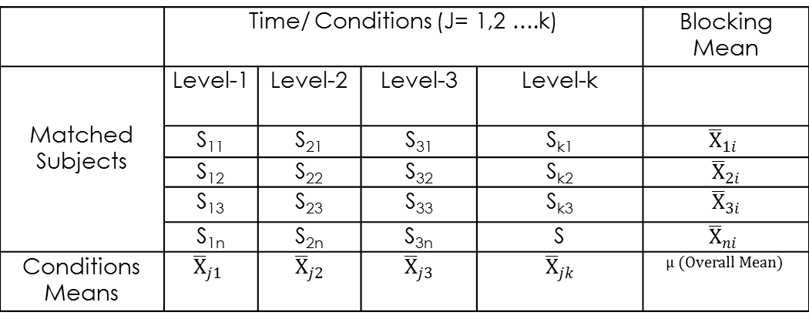
Table 19.3 Experiment Design: One-Way ANOVA Repeated Measures
 | Time/Conditions (J = 1,2…. k) |  |  |  | Blocking Mean
Matched subjects | Level-1 | Level-2 | Level-3 | Level-k
 | S₁₁ | S₂₁ | S₃₁ | S_{k1}
 | S₁₂ | S₂₂ | S₃₂ | S_{k2}
 | S₁₃ | S₂₃ | S₃₃ | S_{k3}
 | S_{1n} | S_{2n} | S_{3n} | S
Conditions means

Slide 13
Framing Hypothesis
Research problem and test technique: We will measure the difference in taste preference of three different kinds of cake recipes among certain groups of customers in repeated manner by using the data set cake_recipe.sav.
To design this experiment, the taste preferences of 40 randomly selected customers are measured thrice on a repeat manner.
Assessing normality
Exhibit 19.1. Use cake_recipe.sav » Menu bar » analyse » Non-parametric test » Legacy Dialogs » One sample KS test » Transfer Creaming method, One-bowl method and Cream-and-whip-method to Test Variable(s) List » Click on Normal distribution under Test Distribution » Click OK

Slide 14
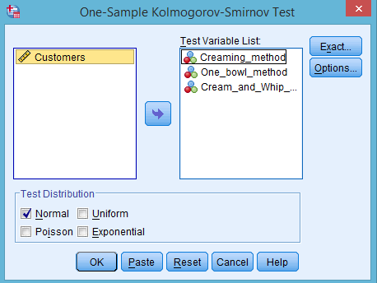
Table 19.4. Assessing Normality with One-Sample KS
Recipe Methods | N | Normal Parameters |  | K-S Z | Sig. (2-tailed)
 |  | Mean | Std. Deviation
Creaming | 40 | 4.1 | 2.4 | 0.134 | 0.070
One-bowl | 40 | 6.0 | 2.3 | 0.121 | 0.146
Cream-and-Whip | 40 | 5.6 | 2.3 | 0.116 | 0.186

Slide 15
The p-value (Sig. (2-tailed)) as shown in the last column of these observations is more than 0.05 (p > 0.05. p = 0.070, 0.146 and 0.186) for all three measurements at 5 per cent level of significance. Hence, we fail to reject the null hypothesis, indicating the condition of normality.

Slide 16
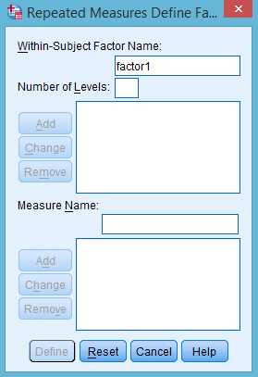
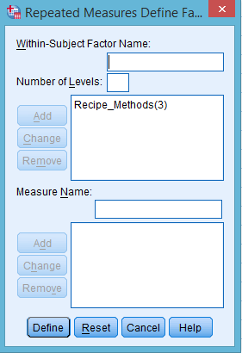
SPSS Path for Specify Repeated Measures Factor
Exhibit 19.2. Use cake_recipe.sav » Menu bar » analyse » General linear model » Repeated Measures » Type Recipe_Methods as factor name and type 3 as Number of Levels » Click Add button » Define

Slide 17
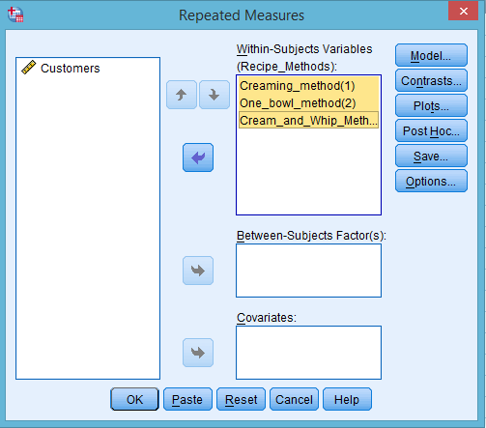
SPSS Path for Mentioning Levels of Independent Factor
Exhibit 19.3. Click Define » Select Creaming method, One-bowl method and Cream-and-whip-method (either select one-by-one or all by pressing shift key) » Transfer to Within-Subjects Variables box

Slide 18
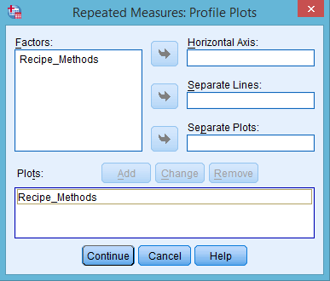
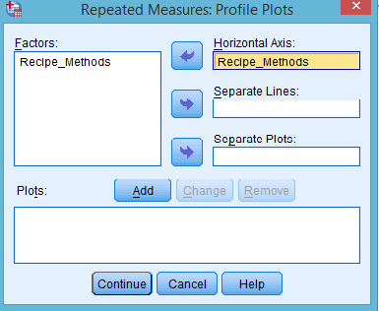
SPSS Path for Computing Profile Plot
Exhibit 19.4. Click Plots » Select Recipe_methods » Transfer in Horizontal Axis » Click on Add button

Slide 19
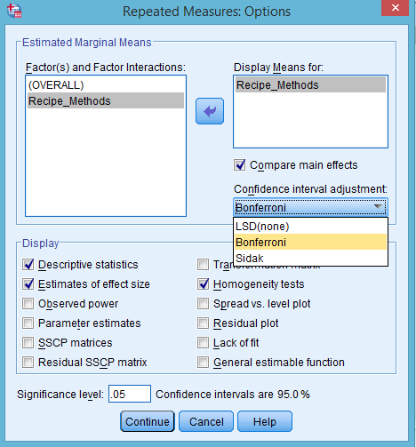
SPSS Path for Computing Descriptive Statistics, Homogeneity Test and Effect Size
Exhibit 19.5. Click Options of Repeated Measures dialog » Transfer Recipe_methods in box Display Means for » Select Compare main effects » Select Bonferroni test from drop menu list of Confidence interval adjustment » Select Descriptive statistics, Homogeneity test and Estimates of effect size in Display column » Continue

Slide 20
Interpreting Outputs of One-Way ANOVA Repeated Measures
Identification of Labels
Table 19.5a. Within-Subjects Factors Measures: One-Way ANOVA Repeated Measures
Recipe Methods | Dependent Variable
1 | Creaming method
2 | One-bowl method
3 | Cream-and-Whip method

Slide 21
Descriptive Statistics between Groups
Table 19.5b. Descriptive Statistics: One-Way ANOVA Repeated Measures
 | Mean | Std. Deviation | N
Creaming_method | 4.1 | 2.4 | 40
One­­_bowl_method | 6.0 | 2.3 | 40
Cream_and_Whip method | 5.6 | 2.3 | 40

Slide 22
Mauchly's Test of Sphericity
Table 19.5c. Mauchly's Test of Sphericity
Mauchly's Test of Sphericity
Within- Subjects Effect | Mauchly's W | Approx. Chi-Square | df | Sig. | Epsilonª
 |  |  |  |  | Greenhouse–Geisser | Huynh–Feldt | Lower-bound
Recipe methods | 0.951 | 1.928 | 2 | 0.381 | 0.953 | 1.000 | 0.500

Slide 23
The sphericity is referred to a condition of equal variances of the difference between all the possible pairs of matched groups (i.e. different levels of independent variable) in the experiment (Field 2009).
As the p-value (0.381) of this test statistic is non-significant (more than 0.05 at 5% LoS), we fail to reject the null hypothesis of equal sphericity and conclude with strong evidence that sphericity is assumed to be same across the matched pairs in the experiment.

Slide 24
Tests of Between-Subjects Effects and Calculations for Sum of Squares, Degrees of Freedom, Mean Sum of Squares, F-Ratios and Partial Eta Squared
Table 19.5d. Tests of Within-Subjects Effects: One-Way ANOVA Repeated Measures
Source |  | Type III Sum of Squares | Df | Mean Square | F | Sig. | Partial Eta Squared
Recipe methods | Sphericity Assumed | 77.2 | 2 | 38.6 | 6.6 | 0.002 | 0.146
 | Greenhouse–Geisser | 77.2 | 1.9 | 40.5 | 6.6 | 0.003 | 0.146
 | Huynh–Feldt | 77.2 | 2.0 | 38.6 | 6.6 | 0.002 | 0.146
 | Lower-bound | 77.2 | 1.0 | 77.2 | 6.6 | 0.014 | 0.146
Error (Recipe Methods) | Sphericity Assumed | 451.4 | 78 | 5.7
 | Greenhouse–Geisser | 451.4 | 74.3 | 6.0
 | Huynh–Feldt | 451.4 | 78.0 | 5.7
 | Lower-bound | 451.4 | 39.0 | 11.5

Slide 25
The p-values associated with F-statistic in the condition of sphericity assumed [F (2,78) = 6.6, p < 0.05, 0.002)] is less than 5 per cent LoS.
Hence, we reject the null hypothesis of equal taste preference for all three methods and would have evidence that significant difference exists in the taste preference between at least any two methods.

Slide 26
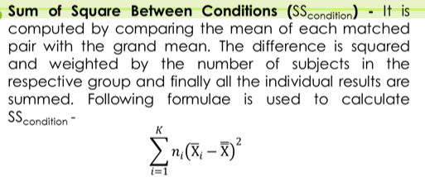
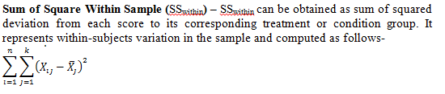
Calculations Required for Main AVONA Table

Slide 27
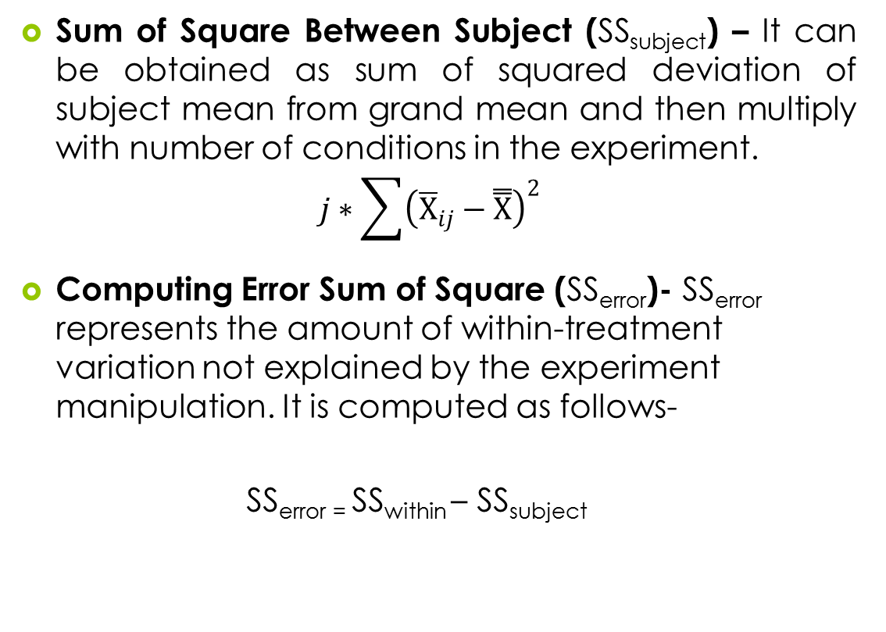

Slide 28
Computing Degrees of Freedom
Table 19.6. Degrees of Freedom: One-Way ANOVA Repeated Measures
Variation Source | Formulae for Degree of Freedom (df) | df
Conditions | Number of conditions−1, (k−1) | 3−1 = 2
Subjects | Number of subjett−1, (N−1) | 40−1 = 39
Error variance | (k−1) × (N−1) | 2 × 39 = 78

Slide 29
Computing Mean Sum of Squares and F-Statistics
Table 19.7. F-Ratios: One-Way ANOVA Repeated Measures
Mean Sum of Square (MS) | Value | F-Ratio | Value
MS = SS/2 | 77.2/2 = 38.6 | F = MS/MS_{Error} | 38.6/5.78 = 6.6
MS_{Error} = SS_{Error}/78 | 451.4/78 = 5.78

Slide 30
Computing Effect Size
Table 19.8. Effect Size: One-Way ANOVA Repeated Measures
Partial Eta Squared | Formulae | Value
η²_{p} | SS_{Condition}/(Ss_{condition} + SS_{error)} | 77.2/17.2 + 451.4 = 0.16

Slide 31
Pairwise Comparison
Table 19.9. Pairwise Comparison: One-Way ANOVA Repeated Measures
(I) Method | (J) Methods | Difference (I–J) | Std. Error | Sig.^{b} | 95% Confidence Interval for Difference^{b}
 |  |  |  |  | Lower Bound | Upper Bound
1 | 2 | −1.850ª | 0.544 | 0.005 | −3.210 | −0.490
 | 3 | −1.500ª | 0.480 | 0.010 | −2.702 | −0.298
2 | 1 | 1.850ª | 0.544 | 0.005 | 0.490 | 3.210
 | 3 | 0.350 | 0.585 | 1.00 | −1.112 | 1.812
3 | 1 | 1.500ª | 0.480 | 0.010 | 0.298 | 2.702
 | 2 | −0.350 | 0.585 | 1.00 | −1.812 | 1.112
ªThe mean difference is significant at the 0.05 level.
^{b}Adjustment for multiple comparisons: Bonferroni.

Slide 32
On the basis of p-value (at 5% level of significance), we have statistical evidence in support for not to reject the null hypothesis of equal taste preference for only one pair (2 and 3; One-bowl and Cream-and-whip-method) among all the possible pairs due to higher p-values.

Slide 33
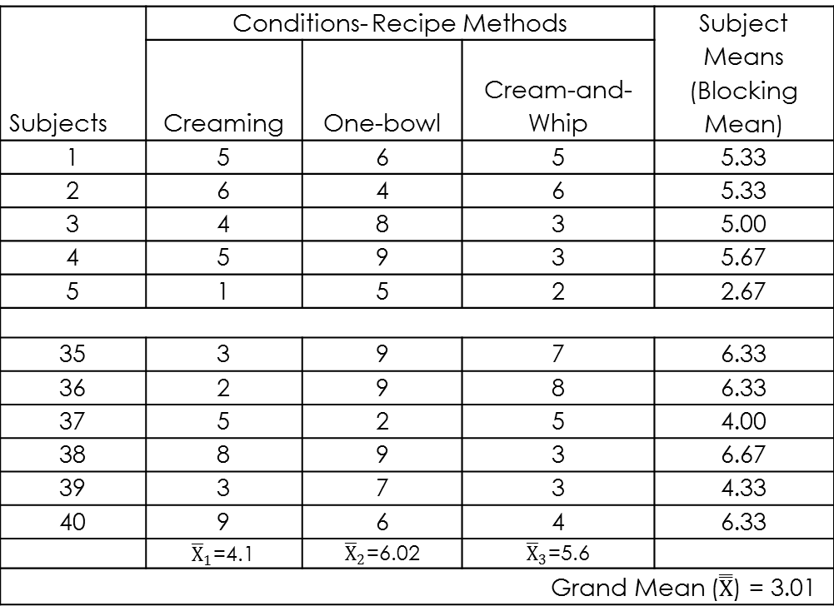
Sample Data with Repeated Observations
Table 19.10. Sample-Data: One-Way ANOVA Repeated Measures
Subjects | Conditions- Recipe Methods |  |  | Subject Means (Blocking Mean)
 | Creaming | One-bowl | Cream-and-Whip
1 | 5 | 6 | 5 | 5.33
2 | 6 | 4 | 6 | 5.33
3 | 4 | 8 | 3 | 5.00
4 | 5 | 9 | 3 | 5.67
5 | 1 | 5 | 2 | 2.67
35 | 3 | 9 | 7 | 6.33
36 | 2 | 9 | 8 | 6.33
37 | 5 | 2 | 5 | 4.00
38 | 8 | 9 | 3 | 6.67
39 | 3 | 7 | 3 | 4.33
40 | 9 | 6 | 4 | 6.33

Slide 34
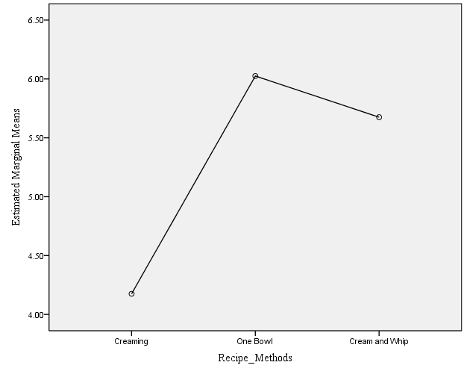
Displaying Estimated Marginal Means
Figure 19.7. Displaying Interaction between Factors
The estimated marginal means of taste preference is displayed at vertical (Y) axis, whereas three recipe methods are at horizontal (X) axis.
We can easily interpret a significant difference in the taste preference among all the methods as shown in Figure 19.7.

Slide 35
Reporting the Results of One-Way ANOVA Repeated Measures
The p-values associated with F-statistic in sphericity assumed condition [F (2,78) = 6.6, p < 0.05, 0.002)] is less than 5 per cent level of significance. Hence, we reject the null hypothesis of equal taste preference for all the three methods.
The results of pair-wise comparison of main effect form the measures of Bonferroni confidence interval adjustment and indicate that null hypothesis of equal taste preference is fail to reject for only one pair (2 and 3; One-bowl and Cream-and-whip-method) among due to higher p-value (p > 0.05, 1.00) at 5 per cent LoS.
The measure of Partial Eta Squared indicates that 16 per cent proportion of variance in the taste preference is explained by the factors incorporated in the experiment.

Slide 36
Key Terms
Blocking mean Conditions Variance Effect size Epsilon measures Error variance Eta squared General Linear Model Univariate Analysis Greenhouse-Geisser correction Marginal means | Matched case Mauchly’s test of sphericity Partial Eta squared Profile plots Repeated measures Treatment effect Unexplained variance

